Slide 1
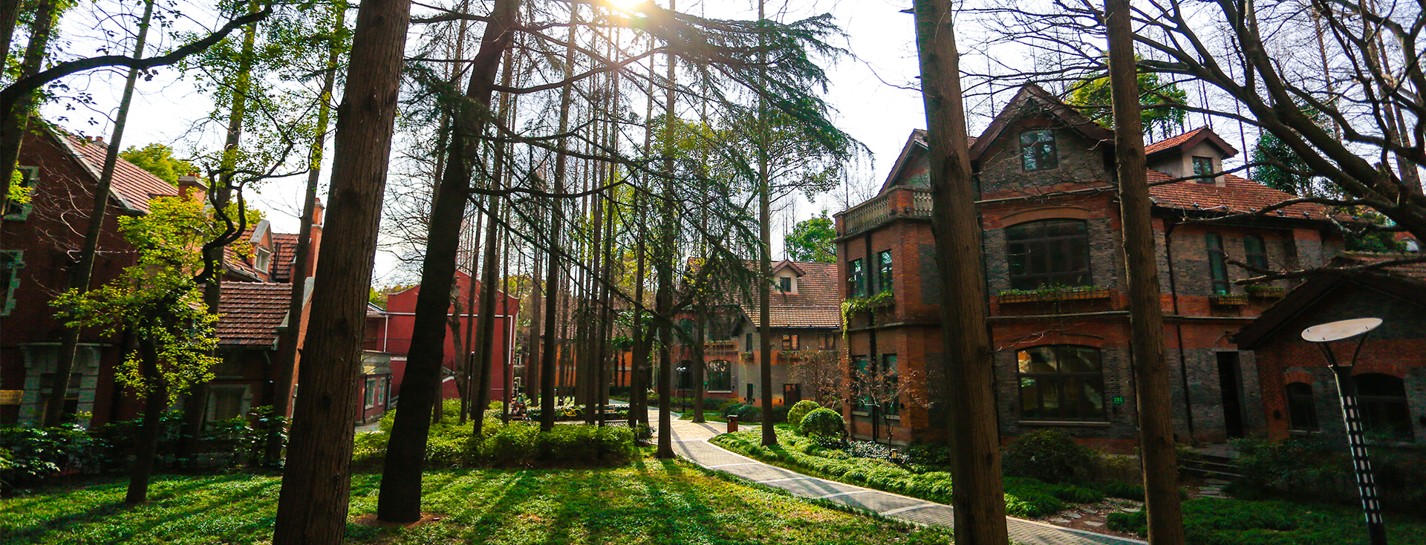
上 海 理 工 大 学 University Of Shanghai For Science And Technology
学院设置
导师信息网址
School of Energy & Power Engineering
School of Optical-Electrical and Computer Engineering
Business School
Business School
Business School
School of Mechanical Engineering
School of Foreign Language
School of Environment and Architecture
College of Communication and Art Design
School of Medical Instrument and Food Engineering
College of Science
School of Materials Science and Engineering
School of Marxism
http://ndxy.usst.edu.cn/index.php?m=Index&a=single&id=6&cid=73
http://oece.usst.edu.cn/Default.aspx?tabid=158
http://bs.usst.edu.cn/szdw/list.htm
（English website: - Down for Maintenance ）
（English website: - Down for Maintenance ）
http://me.usst.edu.cn/3344/list.htm
http://waiyu.usst.edu.cn/s/56/t/694/p/10/c/4851/d/6221/list.htm
http://sea.usst.edu.cn/1636/list.htm
http://ccad.usst.edu.cn/index.php/index/category/catid/33.html
http://yiliao.usst.edu.cn/4168/list.htm
http://lxy.usst.edu.cn/2261/list.htm
http://clxy.usst.edu.cn/3601/list.htm
http://mksxy.usst.edu.cn/2720/list.htm

Slide 2
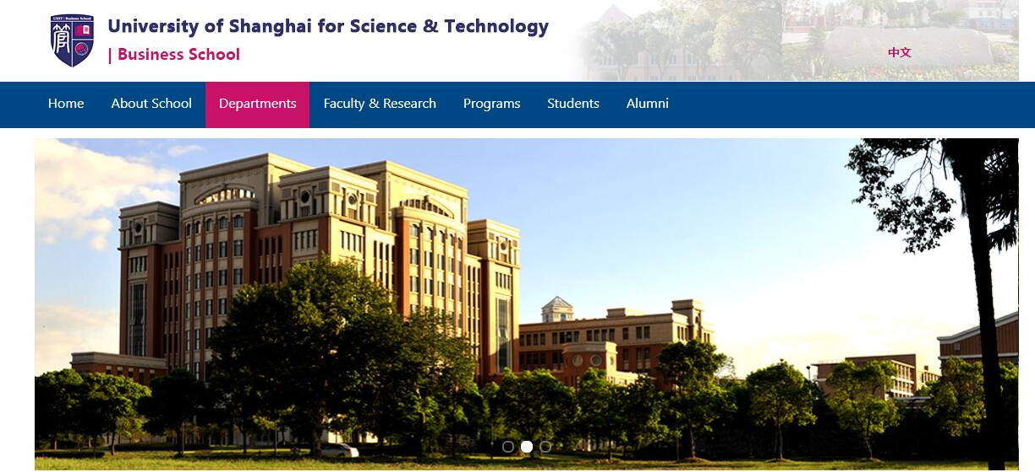
Sample:

Slide 3
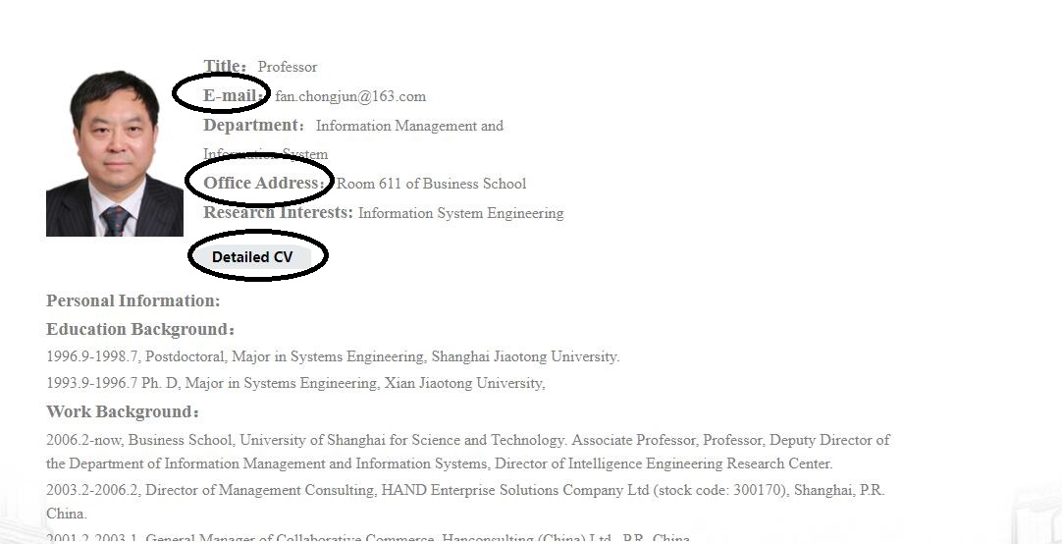
Sample-Professor FAN from Business School:

