Slide 1


Annual Review of the Chinese Government Scholarship and the Shanghai Municipal Government Scholarship for International Students
International Affairs Office (International Student Office),
September 2026

Slide 2
Annual Review Process
May: Quantitative scoring and qualitative evaluation
April: Supervisors complete the “Review and Scoring Form”
May: Reviewed and approved by the University International Student Affairs Leading Group
April: Students complete the self-assessment form
August: CSC approves the annual review results of Chinese Government Scholarship students
International Affairs Office publicizes the annual review results (June–August)

Slide 3
Scope of Students for Review (Taking the Spring 2027 Scholarship Annual Review as an Example)
In principle, students who will continue to receive the scholarship after September 2027 (whose quota falls within the approved plan), including doctoral students who are unable to graduate in July 2027 as scheduled, or who, owing to suspension of study, are unable to graduate in January 2028 under the scholarship plan and intend to apply for an extension.
Students whose scholarship was suspended after failing the 2026 review must participate in order to apply for restoration.

Slide 4
Review Outcome
Qualified
Not Qualified
Total score of 60 or above
No withdrawal warning
No disciplinary probation
Total score below 60, or
A withdrawal warning, or
Disciplinary probation
Scholarship Suspended
Scholarship Continued
Failed only the current year’s review
Suspended for 1 year; self-funded and can be restored if qualified the next year
Qualified in current and all previous annual reviews
Scholarship Restored
Scholarship Cancelled
Scholarship suspended in the previous annual review; qualified in current year’s review
Withdrawn or expelled, or
two failed annual reviews in total, or
non-participation without justified reason
Note: Students whose Category A Shanghai Municipal Government Scholarship was downgraded to Category B may regain Category A status with priority if rated Excellent in the next annual review.

Slide 5
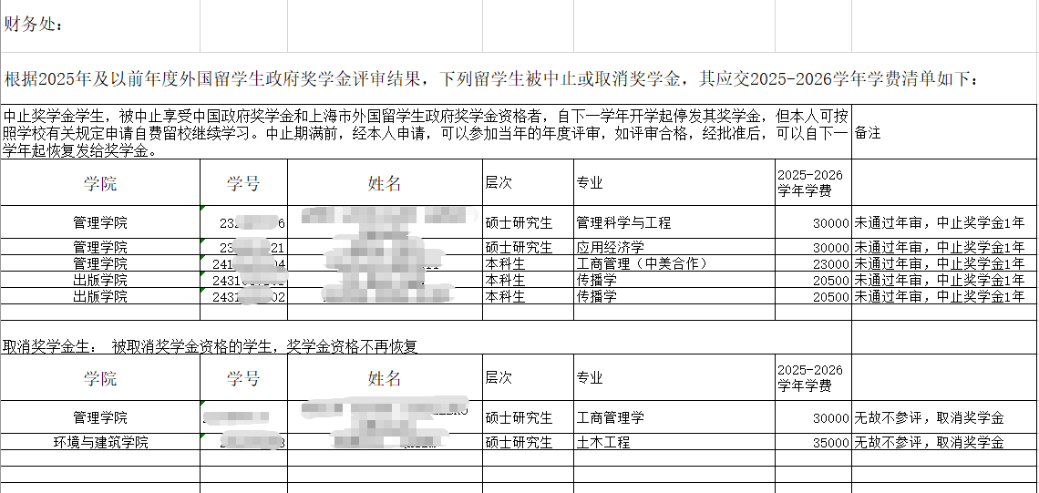
Annual Review Results
The secretariat of the University International Student Affairs Leading Group notifies relevant department/institution of the annual review results (changes of tuition fee)

Slide 6
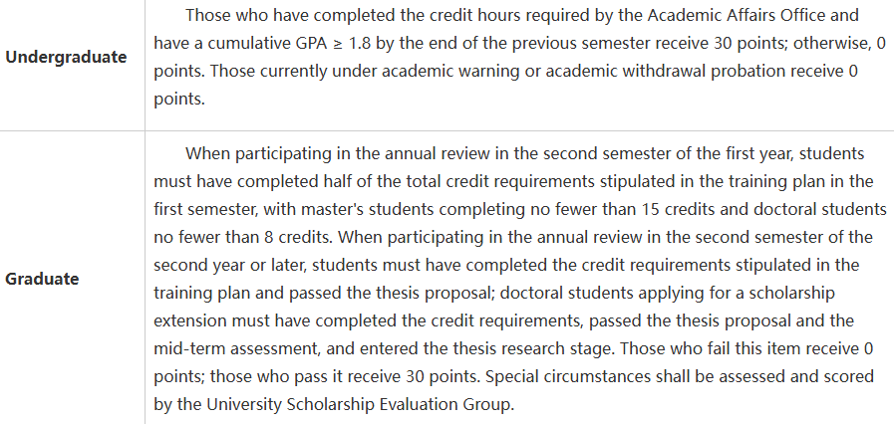
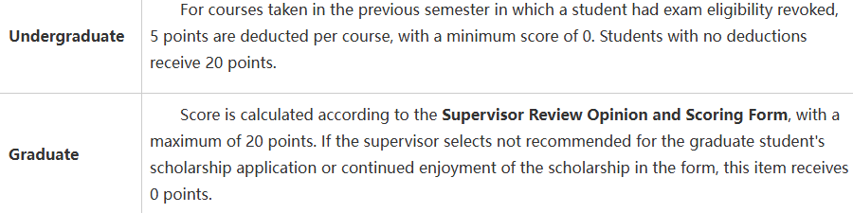
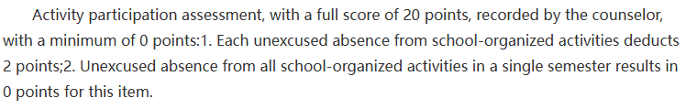
Review Content and Detailed Rules for Quantitative Scoring
Notice on Revising the 2027 Scoring Criteria for the Annual Review of Government Scholarships for International Student at University of Shanghai for Science and Technology
http://isoe.usst.edu.cn/2026/0915/c9774a370523/page.htm
Moral Character – Max. 30 points
Academic Performance – Max. 30 points
Good moral conduct: 30 points; disciplinary sanction in force: 0 points.
30
30
20
20
Learning /Research Attitude – Max. 20 points
Activity Participation – Max. 20 points

Slide 7
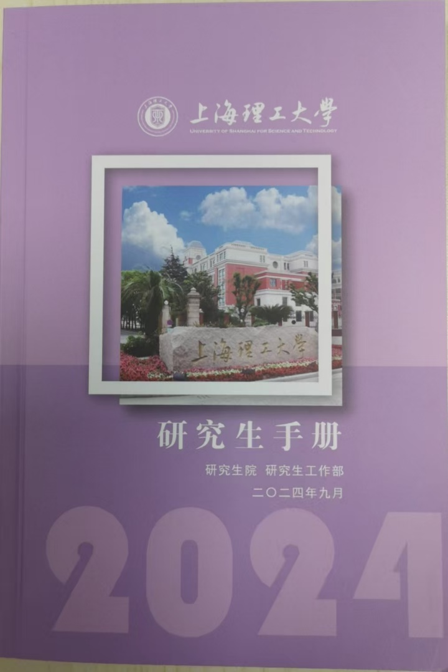
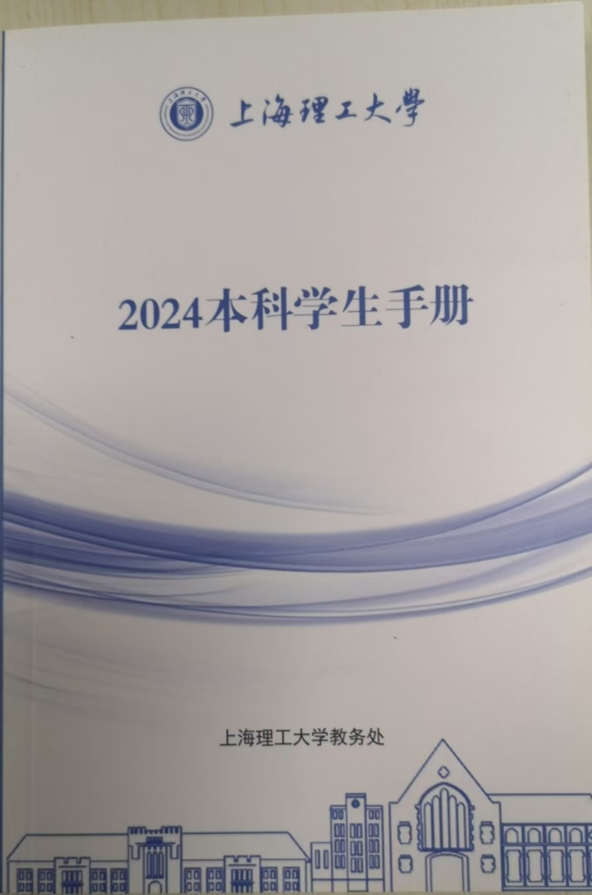

Reference Documents for the Formulation of the Scoring Rules

Slide 8

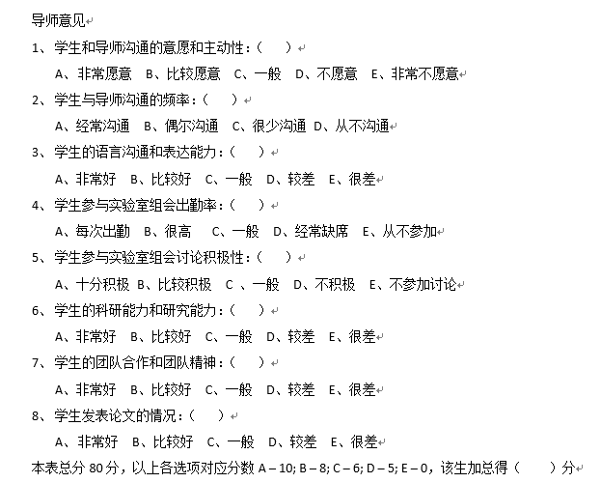
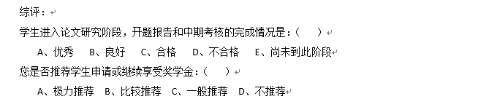
Supervisor Scoring Form

Slide 9

Thanks.

